Slide 1
CHECK STYLE
Yurii Mota

Slide 2
AGENDA
CheckStyle
Examples of available modules
Checkstyle IntelliJ IDEA

Slide 3
CeckStyle
Checkstyle is a static code analysis tool used in software development for checking if Java source code complies with coding rules.
The programming style adopted by a software development project can help to ensure that the code complies with good programming practices which improves the quality, readability, re-usability of the code and may reduce the cost of development. The checks performed by Checkstyle are mainly limited to the presentation of the code.

Slide 4
Examples of available modules
Javadoc comments for classes, attributes and methods;
Naming conventions of attributes and methods;
The number of function parameters;
Line lengths;
The presence of mandatory headers;
The use of imports, and scope modifiers;
The spaces between some characters;
The practices of class construction.

Slide 5
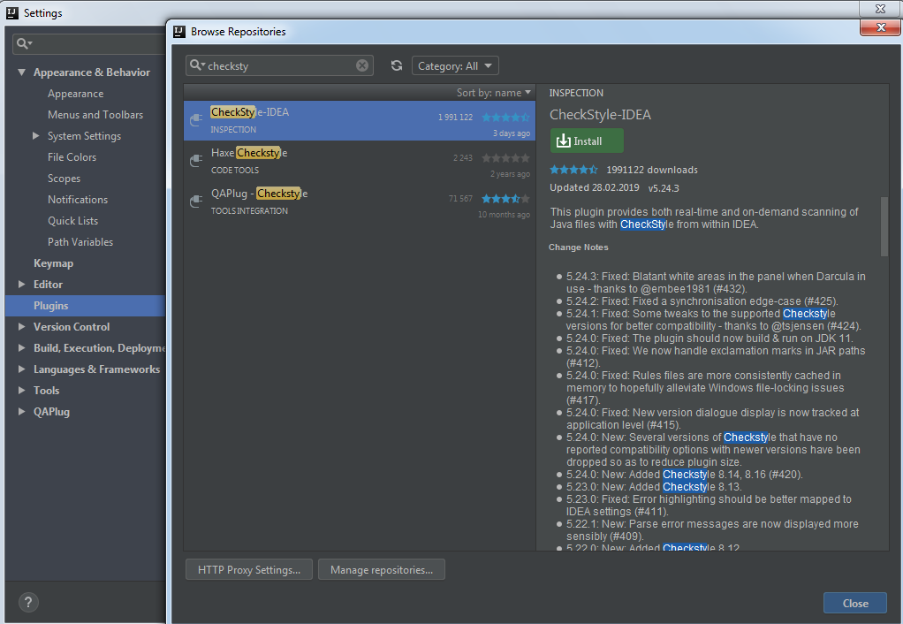
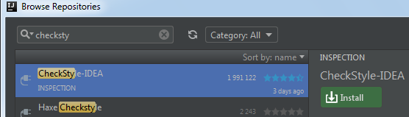
CheckStyle IntelIiJ IDEA

Slide 6
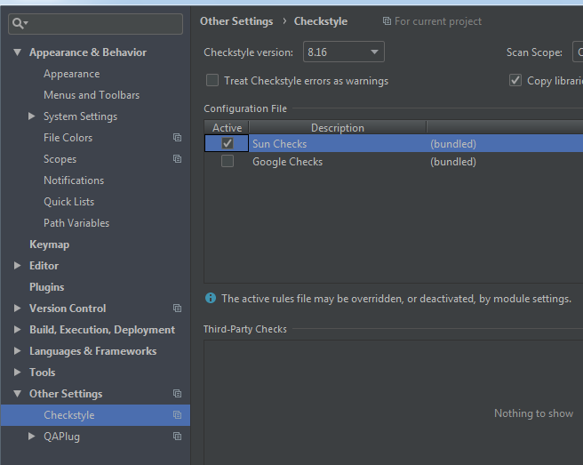
CheckStyle IntelIiJ IDEA

Slide 7
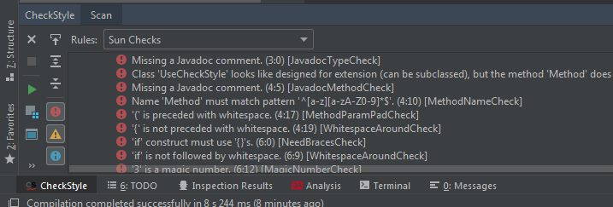
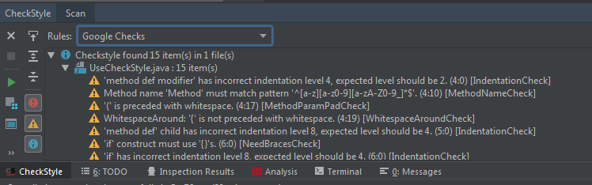
CheckStyle IntelIiJ IDEA

Slide 8
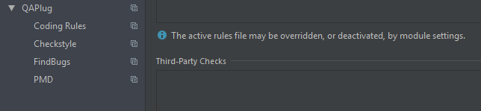
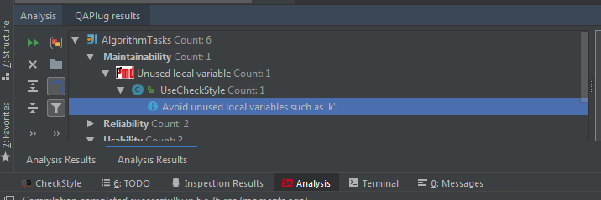
QA Plugins IntelIiJ IDEA

